Slide 1

Predicting Customer Churn in Subscription Services
presented by Muhammed Shafeen pk 05/04/2025 saturday
Name

Slide 2
🔍 Introduction
This dataset represents synthetic customer data for a subscription-based service and is used to analyze and predict customer churn behavior.
1️⃣ Problem Definition
Goal: Predict whether a customer is likely to churn from a subscription-based service.
Business Impact: Reduce customer churn, improve retention, and boost revenue..
ML :Binary classification: 1 = Churned, 0 = Retained

Slide 3
🎯 Objective
Analyze and predict customer churn to identify high-risk segments and improve customer retention in subscription-based services.
🎯 Aim of the Project:
To analyze and predict customer churn in subscription-based services by identifying key behavioral patterns, subscription types, and tenure groups using Power BI visualization

Slide 4
📚 Data Source:
Data source for kaggle , chatgpt ,
🔍 Methodology
📥 Data Collection
understanding the data
🧹 Data Preprocessing
Handling Missing Values
encoding
📊 Exploratory Data Analysis (EDA) model evaluation
📈 Dashboard Creation
measures , card , plot ,

Slide 5
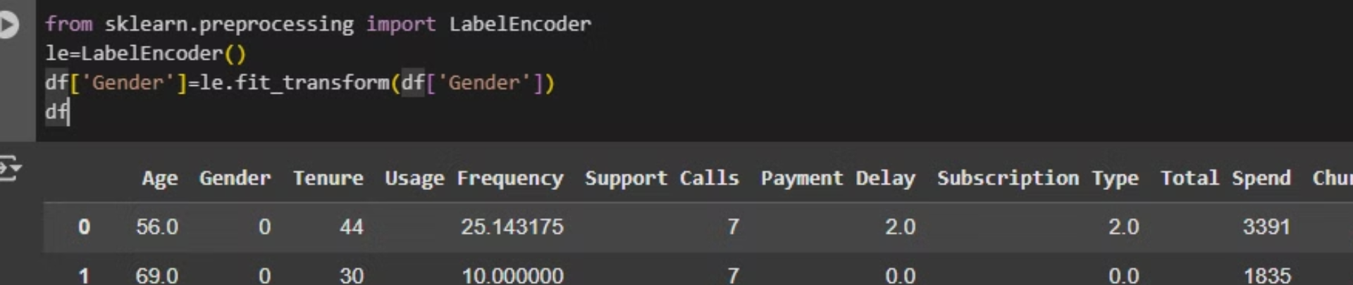
Categorical Data Encoding

Slide 6
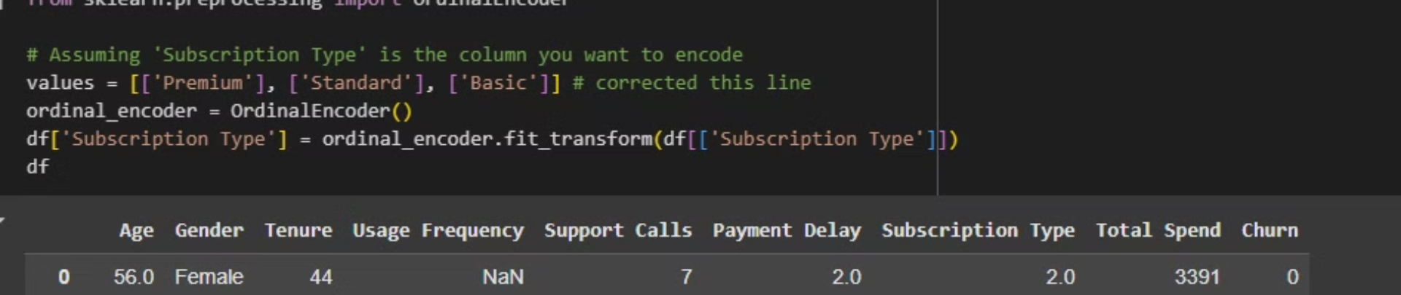
ordinal encoding

Slide 7
🔍 Algorithms Used for Customer Churn Prediction
Model Selection & Implementation
Logistic Regression
Random Forest Classifier
Gradient Boosting Classifier
🧪 Training Process
🔹 1. Data Splitting
Dataset split into:
Training Set: 80%
Test Set: 20%

Slide 8
🧠 Model Interpretability
Model
Interpretability
Accuracy
Speed
Comments
Logistic Regression
⭐⭐⭐⭐⭐
⭐⭐⭐
⭐⭐⭐⭐
Good baseline, easy to explain.
Random Forest
⭐⭐⭐⭐
⭐⭐⭐⭐
⭐⭐
Good balance of power & insights.
Gradient Boosting
⭐⭐☆☆☆
⭐⭐⭐☆☆
Good accuracy / best mode;l
⭐⭐⭐⭐⭐

Slide 9
📊 Evaluation & Results
i choose GRADIEANT BOOSTING * it is the best suitable model for my dataset
Accuracy : 0.74
Precision : 0.79
Recall : 0.74
F1 Score : 0.72

Slide 10
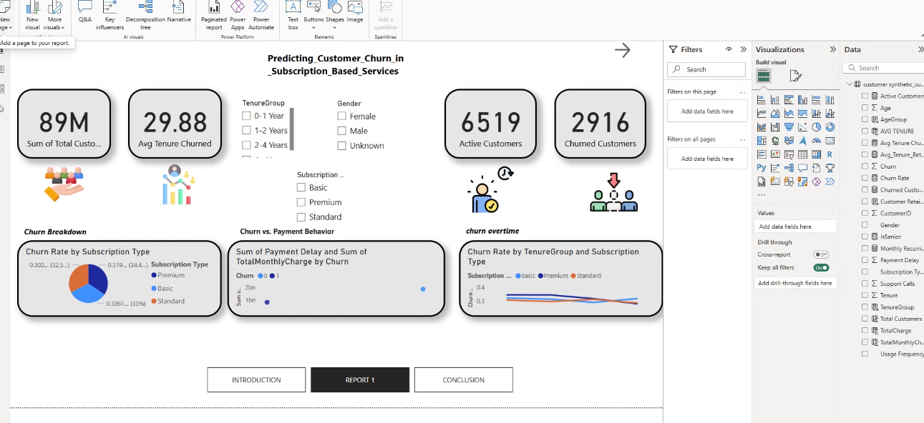
Dashboard

Slide 11
Visual Breakdown
pie chart ; churn breakdown
scatterplot : churn vs payment behavior
line chart : churn vs overtime
slicer : gender subscription type tenure group
cards : *total customer average tenure churned active customer churned customer

Slide 12
🔍 Challenges Faced
Data Imbalance
Missing or Inconsistent Values
Categorical Data Encoding
ML or Predictive Modeling Extensions

Slide 13
THANK YOU
Name

